Slide 1
CS 252 Final Project
Lab 6 Demo Slides
Created by Aaron Peters - peter177

Slide 2
Project info
Section 1
Created by Aaron Peters
Purdue University Student

Slide 3
Project basic information
Project Name
Purdue Planner
Project Platform
iOS
Project Brief Description
I created a simplified virtual mortal board for students at Purdue University. My app is much easier to use and more beneficial than any ‘class planner’ app on the market.
Project Features
See upcoming assignments that are due either tonight or tomorrow
Add a new assignment or edit an existing one
3-week view: Shows a custom-made calendar view for the next 3 weeks. Each calendar table cell has a number indicating how many assignments are due on that day
Repeating weekly assignments: User can add/edit assignments that they want to repeat every week. This way, they don’t have to re-enter them each week
Other basic settings
Created by Aaron Peters
Purdue University Student

Slide 4
All project guidelines were met
Network component
Parse
Used to store all user assignments that are not repeating
Used for user data such as login and basic settings
SQL component
SQLite3 for iOS
Used to store all repeating assignments locally on the user’s phone. Since repeating assignments don’t get changed very often, it is much faster to store these assignments locally using SQLite3 instead of making a network request each time the user tries to load them.
Repeating Assignments stored using SQLite3 were still updated with Parse database when user made changes to them.
Source Control
GitHub
Private repo was used
Created by Aaron Peters
Purdue University Student

Slide 5
Screenshots of app
Section 2
Created by Aaron Peters
Purdue University Student

Slide 6
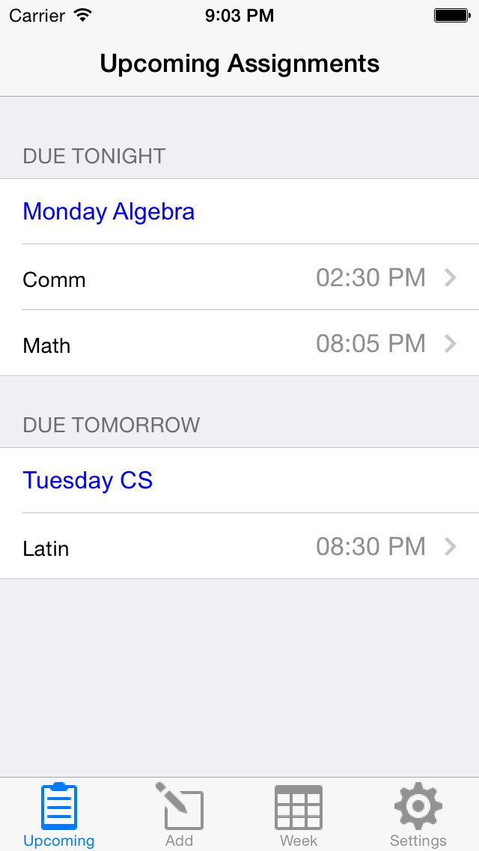
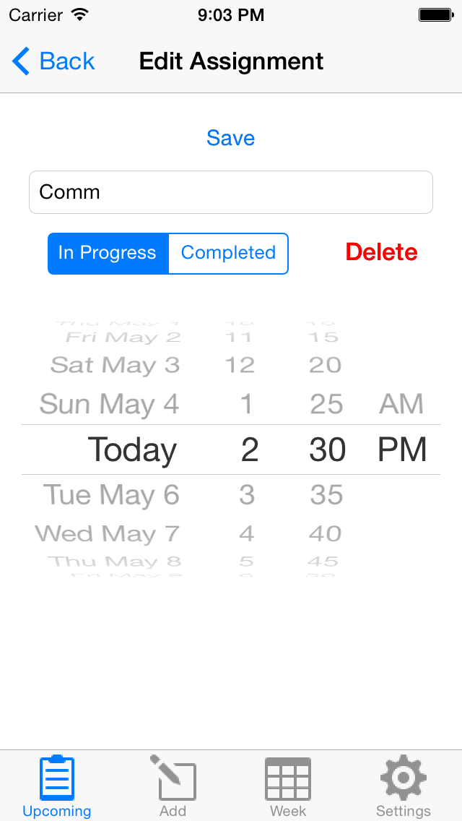
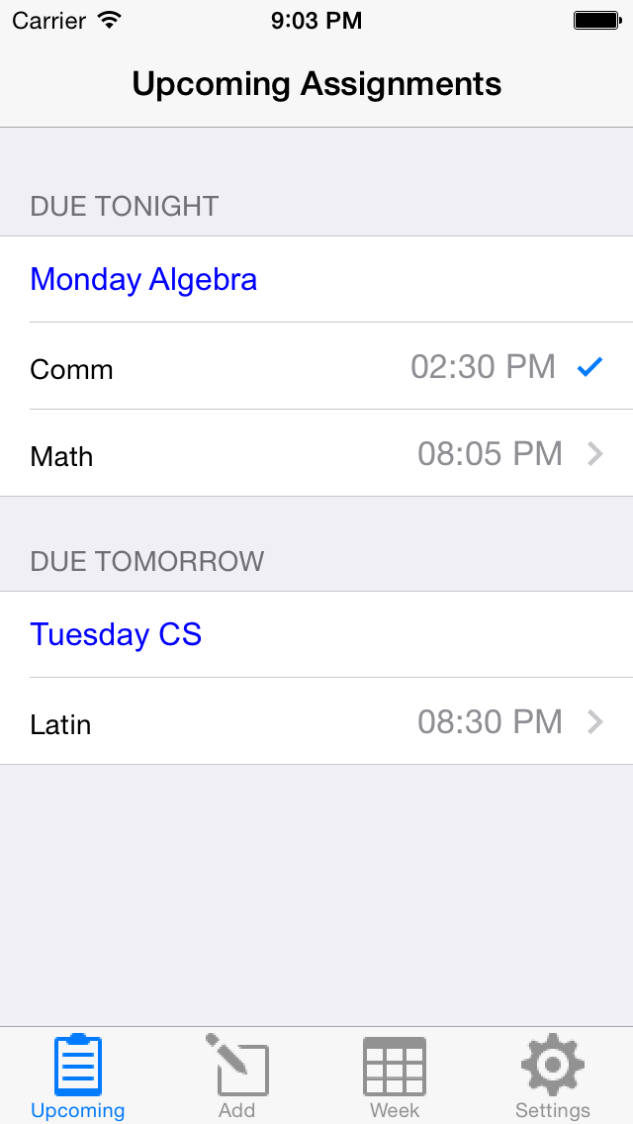
upcoming assignments
Repeating assignments are in blue. Custom assignments are in grey and include a time due
Users can edit these assignments
The checkmark indicated an assignment is complete
Created by Aaron Peters
Purdue University Student

Slide 7
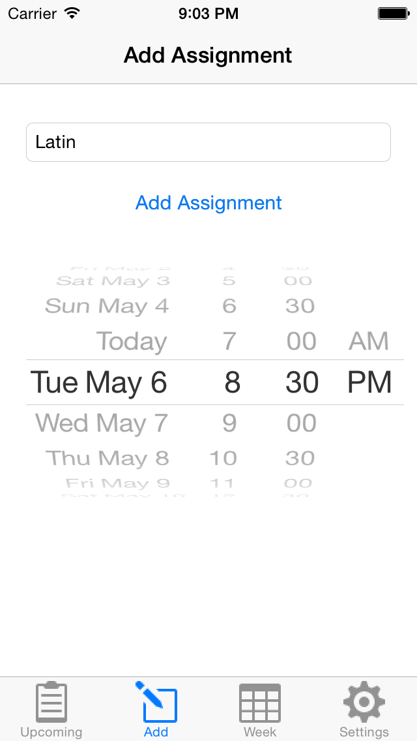
Add Assignment
In addition to repeating assignments, users can add custom assignments
Created by Aaron Peters
Purdue University Student

Slide 8
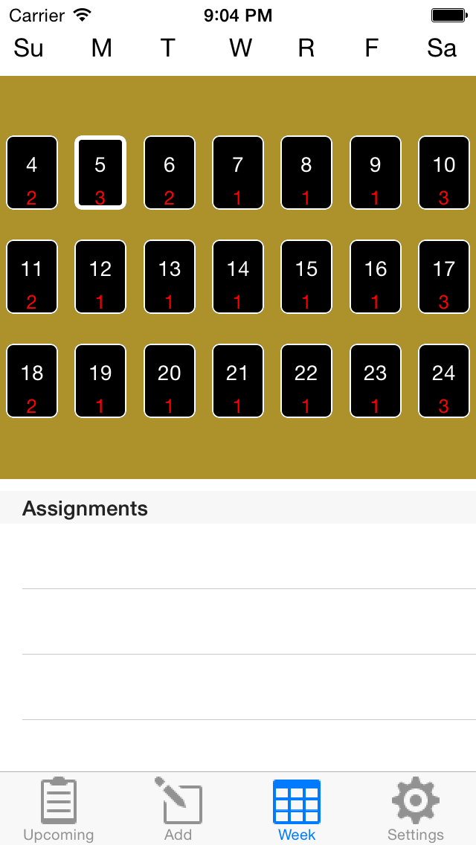
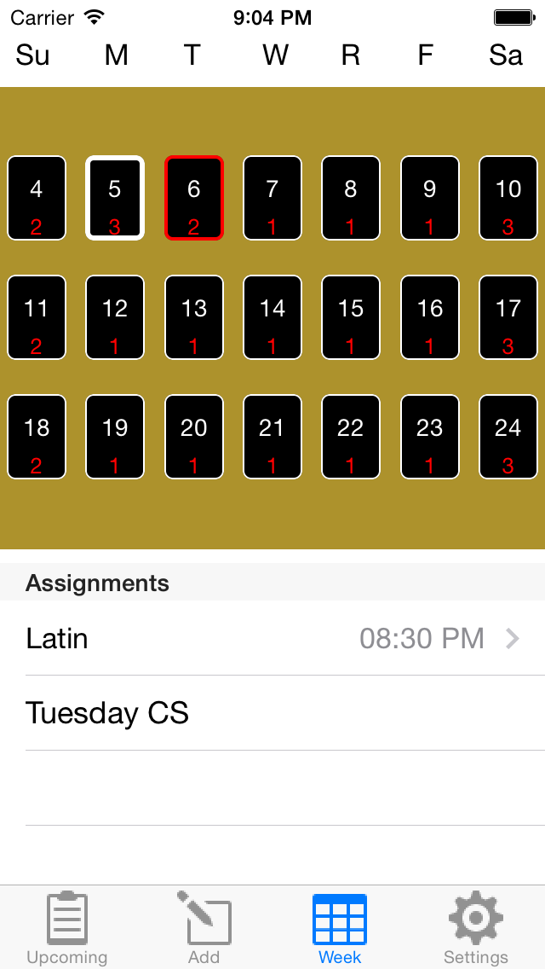
3-Week view
The 3-week view shows the current and next 2 weeks (starting on Sunday) with the number of assignments due that day in red. Today’s date is highlighted in bold white.
When the user clicks on a date, that cell is highlighted in red. Today’s date still in bold white. Users can then see their assignments due for that day below. They can click on an assignment and edit it.
Created by Aaron Peters
Purdue University Student

Slide 9
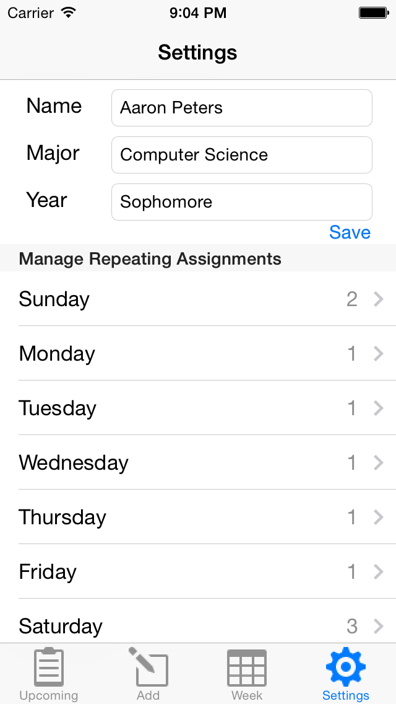
Settings
This is the user’s settings page. The user is logged in through Parse. The user’s repeating assignments are stored locally via SQLite3 and globally through Parse. The next slide shows how users can manage repeating assignments.
Created by Aaron Peters
Purdue University Student

Slide 10
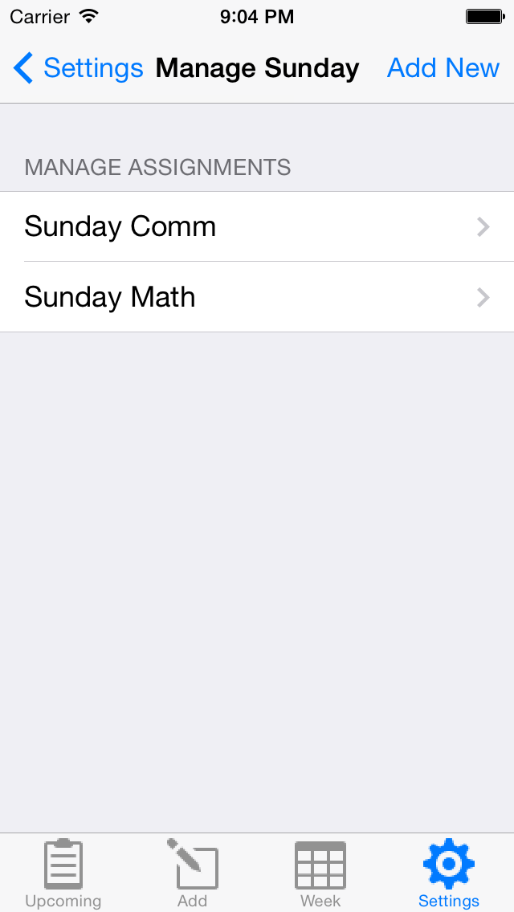
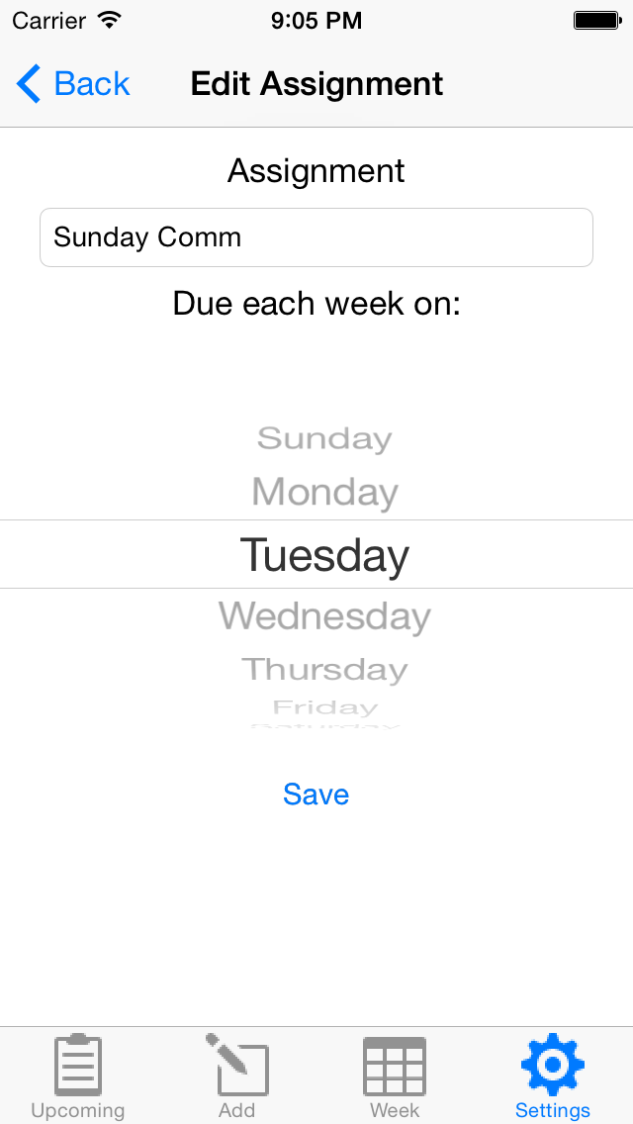
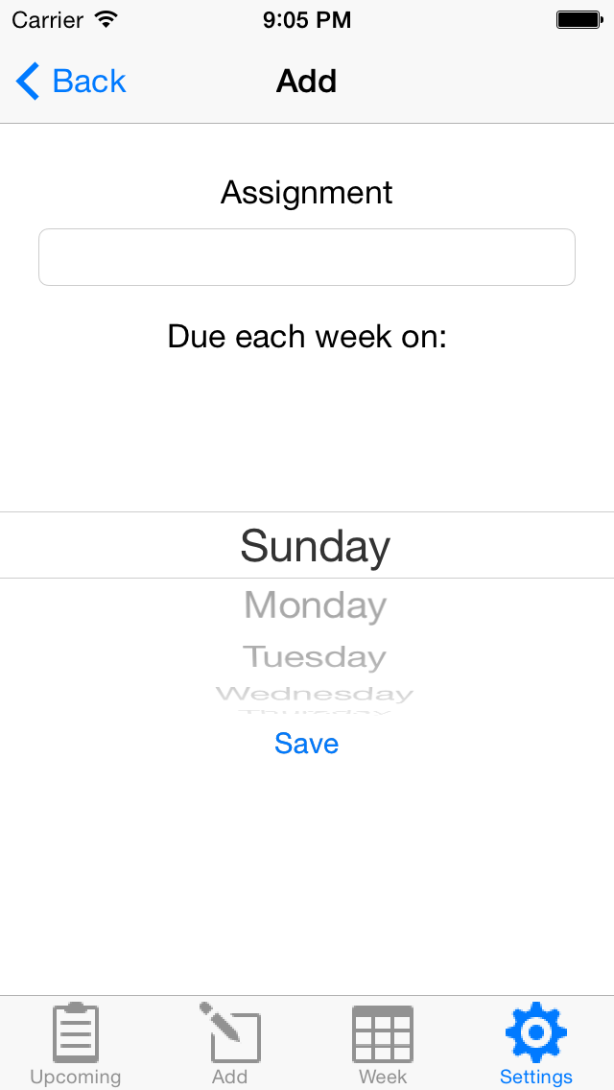
Manage repeating assignments
When the user clicks on a day in the repeating assignments table previously shown, they are then listed all repeating assignments for that day
The user can either click on one of the assignments listed to edit it
The user can add a new repeating assignment for that day
OR
Created by Aaron Peters
Purdue University Student

Slide 11
Future Plans
Section 3
Created by Aaron Peters
Purdue University Student

Slide 12
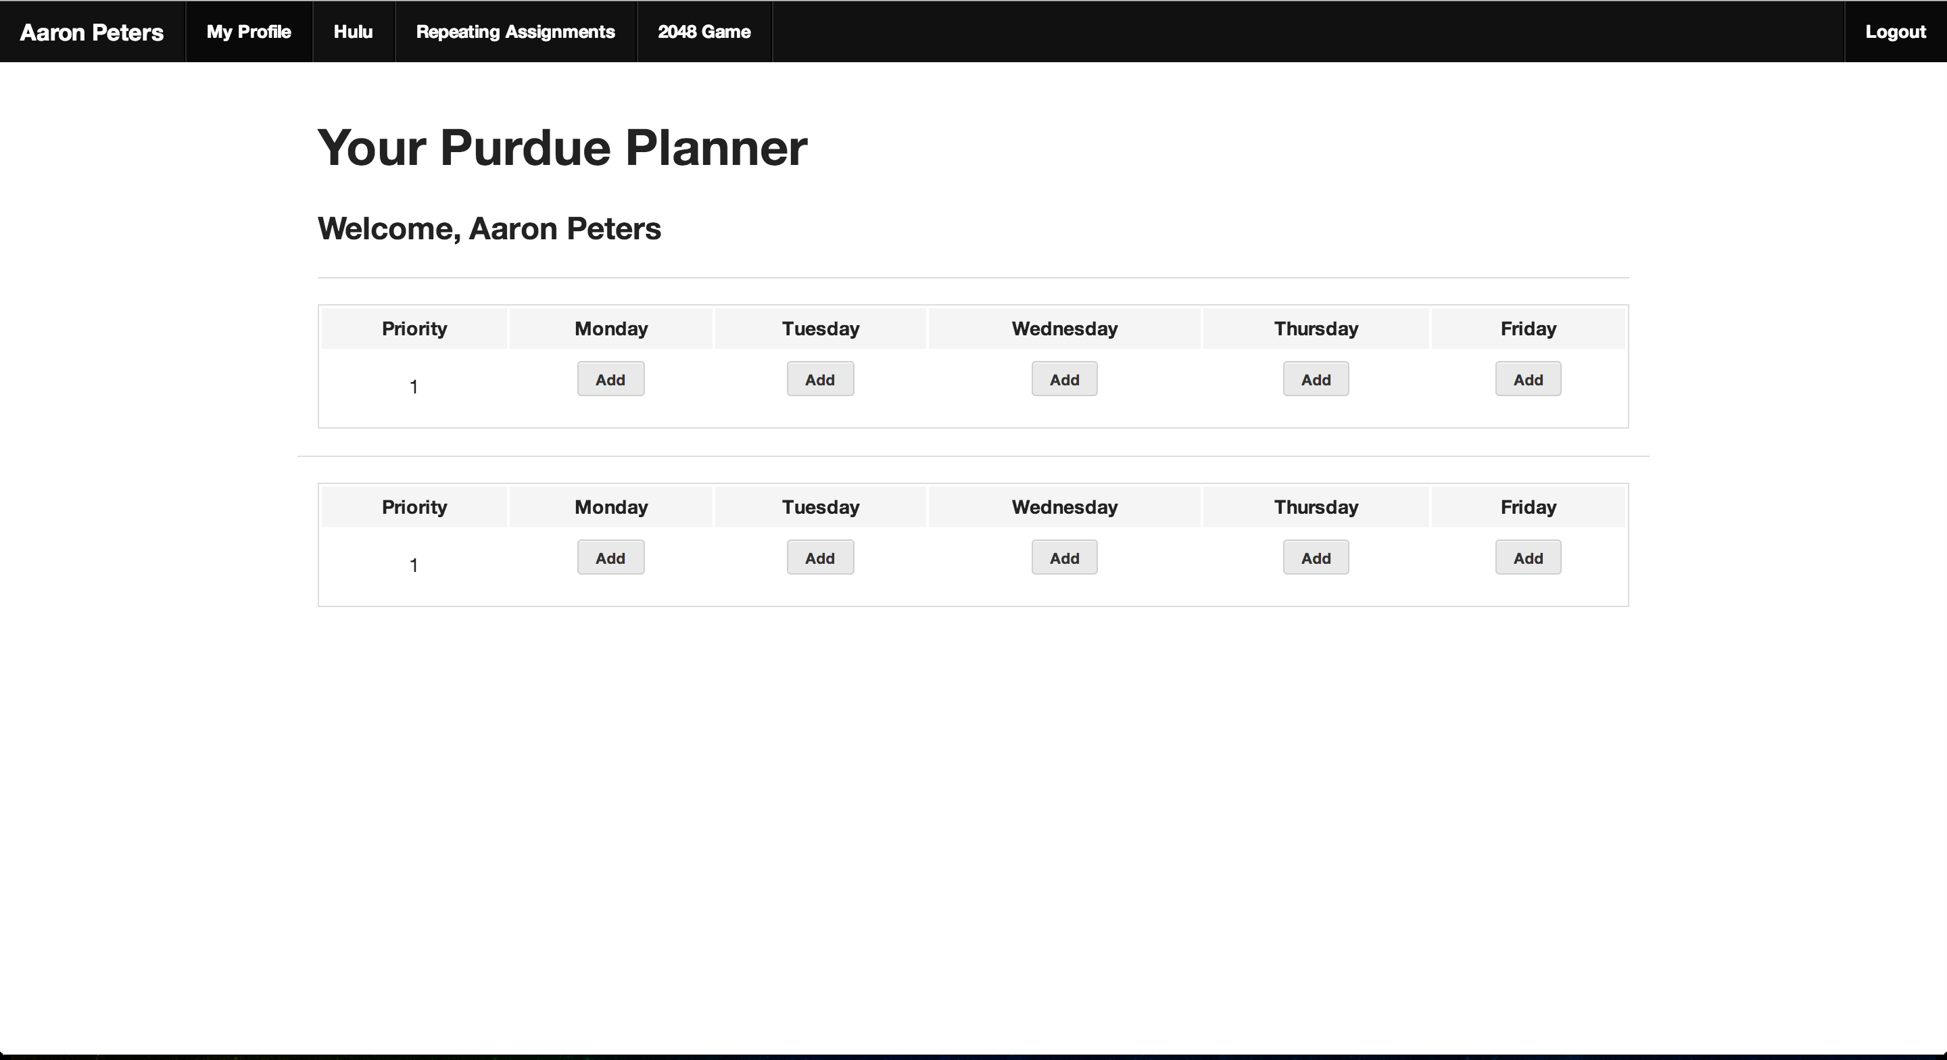
In the future, I plan to code my app for android users and implement a web ui
Here is a mock UI I created for the web that users could access. This is available at my Purdue website: Click Here
Created by Aaron Peters
Purdue University Student

